Slide 1

CSCI 466: Networks
Link Layer
Reese Pearsall Fall 2022
https://www.cs.montana.edu/pearsall/classes/fall2022/466/main.html
*All images are stolen from the internet
1

Slide 2
Announcements
NO CLASS next Friday 11/11
Might have to also cancel next Monday (11/7)*

Slide 3

Application Layer
OSI Model
Presentation Layer
*
Application Layer
Session Layer
*
Messages from Network Applications
Transport Layer
Network Layer
Physical Layer
Data Link Layer
Bits being transmitted over a copper wire
Physical Layer
*In the textbook, they condense it to a 5-layer model, but 7 layers is what is most used

Slide 4

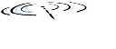
















Data Link Layer
The link layer is responsible for the actual node-to-node delivery of data and ensure error-free transmission of information
We have not addressed how we will overcome various transmission mediums!
terminology:
hosts and routers: nodes
communication channels that connect adjacent nodes along communication path: links
wired links
wireless links
LANs
layer-2 packet: frame, encapsulates datagram
data-link layer has responsibility of
transferring datagram from one node
to physically adjacent node over a link

Slide 5
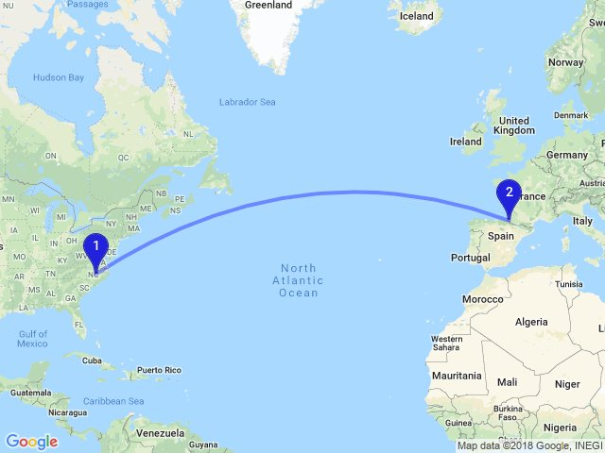
Data Link Layer
Ways to get form US to Paris?
We can visit a travel agent that will give us a travel plan
Take a car to the airport
Take a plane to France
Take a train from Airport to Paris
Take a bus from the train stop to the Eifel tower

Slide 6
Data Link Layer
Ways to get form US to Paris?
We can visit a travel agent that will give us a travel plan
Take a car to the airport
Take a plane to France
Take a train from Airport to Paris
Take a bus from the train stop to the Eifel tower
Tourist = Datagram
Transportation Segment = Link
Airport, Bus Stop, Train Stop = Node
Transport Mode = Link Layer Protocol
Travel Agent = Routing Protocol (Network Layer)

Slide 7
Data Link Layer
Services offered by the Link Layer
Framing
→ Encapsulate a network layer Datagram in another header
Link access
→ LL dictate the rules and process of transmitting a frame over a link
Reliable Delivery
→ For unreliable link, some reliable delivery mechanisms may need to be used
Error Detection and Correction
→ Bits can get messed up as the are transmitted through a medium
Why do we need RDT and error detection in the link layer when it is also offered in the transport layer?

Slide 8
Data Link Layer
Services offered by the Link Layer
Framing
→ Encapsulate a network layer Datagram in another header
Link access
→ LL dictate the rules and process of transmitting a frame over a link
Reliable Delivery
→ For unreliable link, some reliable delivery mechanisms may need to be used
Error Detection and Correction
→ Bits can get messed up as the are transmitted through a medium
Why do we need RDT and error detection in the link layer when it is also offered in the transport layer?
Some packets of data don’t even travel through the transport layer…

Slide 9
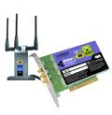
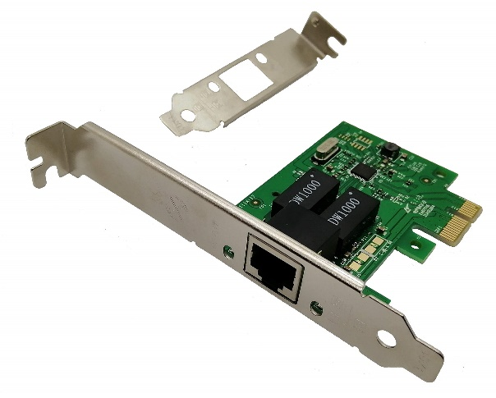

Data Link Layer
Implementation of Link Layer
Implemented within the hardware of your computer
NIC (Network Interface Controller)- Integrated into the motherboard and allows the machine to use LL services such as ethernet (combination of hardware, software, and some firmware)
application
transport
network
link
cpu
memory
link
physical
host
bus
(e.g., PCI)
controller
Wireshark uses your NIC to determine which packets should be sniffed!
physical
transmission
network adapter
card

Slide 10
Data Link Layer
datagram
datagram
controller
controller
sending host
receiving host
datagram
frame
receiving side
looks for errors, rdt, flow control, etc.
extracts datagram, passes to upper layer at receiving side
sending side:
encapsulates datagram in frame
adds error checking bits, rdt, flow control, etc.
Link Layer and LANs
6-10

Slide 11
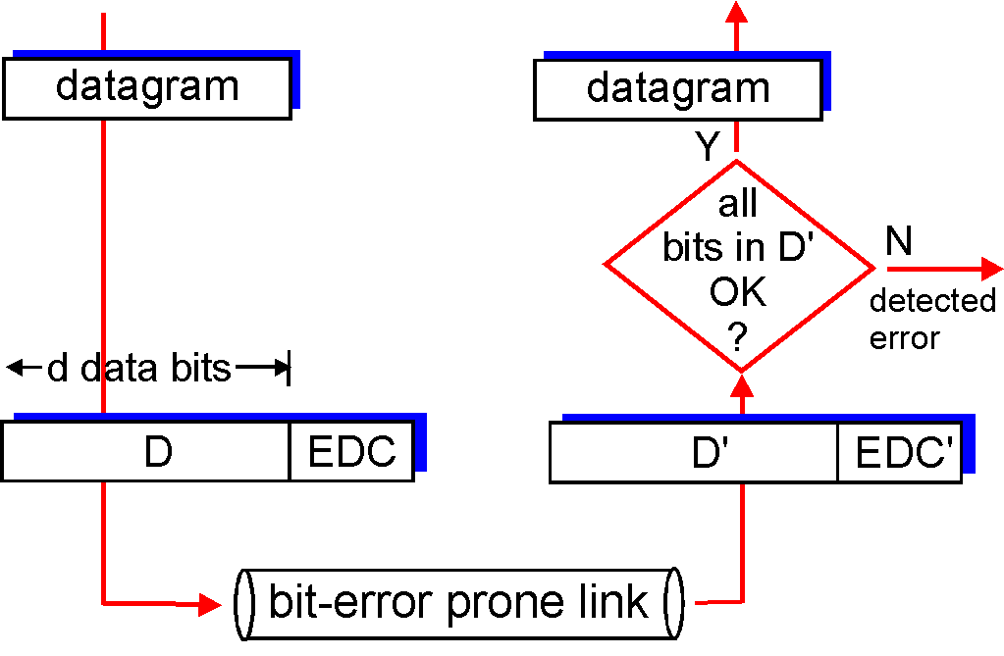
Data Link Layer
Bits can get messed during the physical layer and link layer
Faulty wires
NIC issues
Unreliable mediums
The Data Link Layer implements services for detecting and correcting errors
EDC= Error Detection and Correction bits D = Data protected by error checking, may include header fields
Error detection not 100% reliable!
protocol may miss some errors, but rarely
larger EDC field yields better detection and correction
otherwise
Link Layer and LANs
6-11

Slide 12
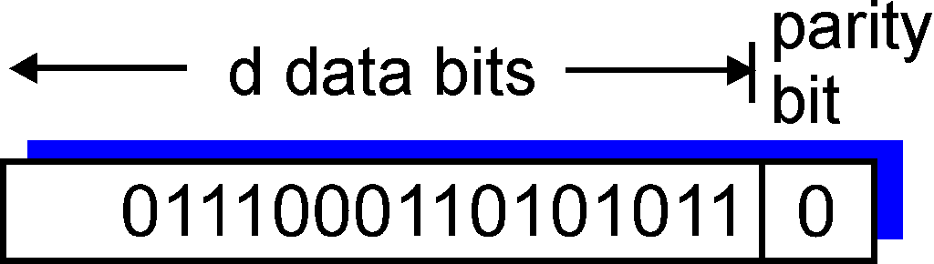
Data Link Layer
Single bit parity:
Detect single bit errors
Is the number of 1s odd (0) or even (1) ? (Including the parity bit)
Data
01110001001010110
The receiver counts eight 1s, but the parity bit tells us it should be an odd number of 1s → ERROR DETECTED
Link Layer and LANs
6-12

Slide 13
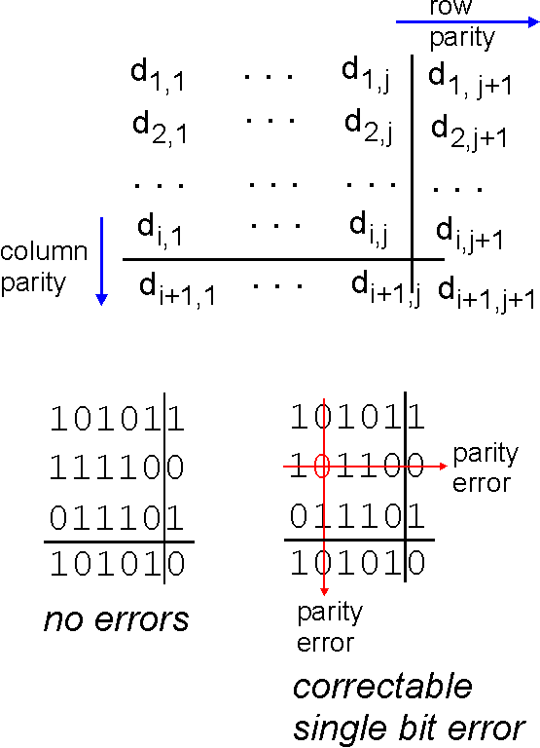
Data Link Layer
Two-dimensional bit parity:
Detect and correct single bit errors
Single bit parity:
Detect single bit errors
Is the number of 1s odd (0) or even (1) ? (Including the parity bit)
Data
01110001001010110
The receiver counts eight 1s, but the parity bit tells us it should be an odd number of 1s → ERROR DETECTED
Link Layer and LANs
6-13

Slide 14
Data Link Layer
Checksum
(Sender)
(Receiver)
0110011001100000
0101010101010101
1000111100001100
0100101011000010
0110011001100000
0101010101010101
1000111100001100
Binary sum of words
0100101011000010
(Binary Sum → One’s Complement)
(one’s complement)
1011010100111101
= 1111111111111111
Checksum!
All 1s = No error!

Slide 15
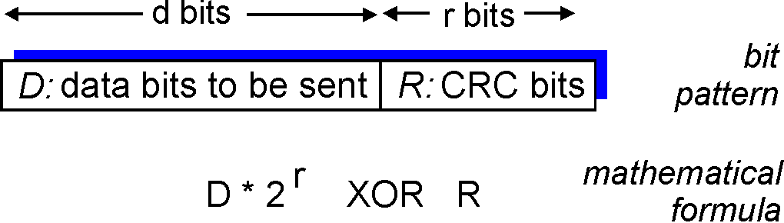
Data Link Layer
more powerful error-detection coding
view data bits, D, as a binary number
choose r+1 bit pattern (generator), G
goal: choose r CRC bits, R, such that
<D,R> exactly divisible by G (modulo 2)
receiver knows G, divides <D,R> by G. If non-zero remainder: error detected!
can detect all burst errors less than r+1 bits
widely used in practice (Ethernet, 802.11 WiFi, ATM)
Sender/Receiver has D and G. Need to compute R
6-15

Slide 16
Data Link Layer
more powerful error-detection coding
view data bits, D, as a binary number
choose r+1 bit pattern (generator), G
goal: choose r CRC bits, R, such that
<D,R> exactly divisible by G (modulo 2)
receiver knows G, divides <D,R> by G. If non-zero remainder: error detected!
can detect all burst errors less than r+1 bits
widely used in practice (Ethernet, 802.11 WiFi, ATM)
Sender/Receiver has D and G. Need to compute R
6-16

Slide 17
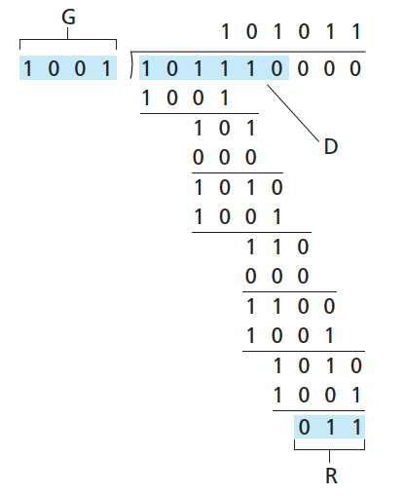

Data Link Layer
(Do some algebra to find R)
D.2^{r}
G
R = remainder[ ]
Sender sends D + R bits.
Receiver divides D + R bits by G. Result should always be Zero if no errors occured
6-17

Slide 18

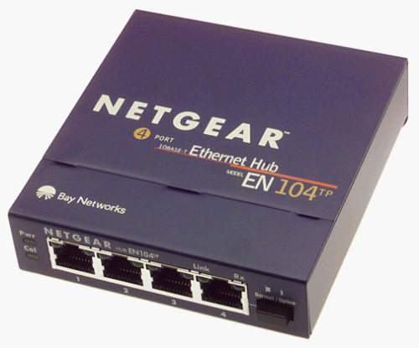


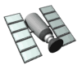

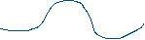
Data Link Layer
Access links
Point to Point – Single sender, Single Receiver at each end of link
Broadcast – shared medium
shared wire (e.g.,
cabled Ethernet)
shared RF
(e.g., 802.11 WiFi)
shared RF
(satellite)
humans at a
cocktail party
(shared air, acoustical)
6-18

Slide 19
Data Link Layer
MAC (Media Access Control) Addresses
32-bit IP address:
network-layer address for interface
used for layer 3 (network layer) forwarding
MAC (or LAN or physical or Ethernet) address:
function: used ‘locally” to get frame from one interface to another physically-connected interface (same network, in IP-addressing sense)
48 bit MAC address (for most LANs) burned in NIC ROM, also sometimes software settable
e.g.: 1A-2F-BB-76-09-AD
hexadecimal (base 16) notation
(each “numeral” represents 4 bits)
How do we know two NICs wont have the same MAC address?
MAC Address is your SSN, IP address is your Postal code ☺
6-19

Slide 20
Data Link Layer
1A-2F-BB-76-09-AD
LAN
(wired or
wireless)
adapter
71-65-F7-2B-08-53
58-23-D7-FA-20-B0
0C-C4-11-6F-E3-98
6-20

Slide 21
Announcements
NO CLASS next Friday 11/11
Monday November 4th = WORK DAY (No lecture)
Input files + sample output for PA3 are on the website

Slide 22
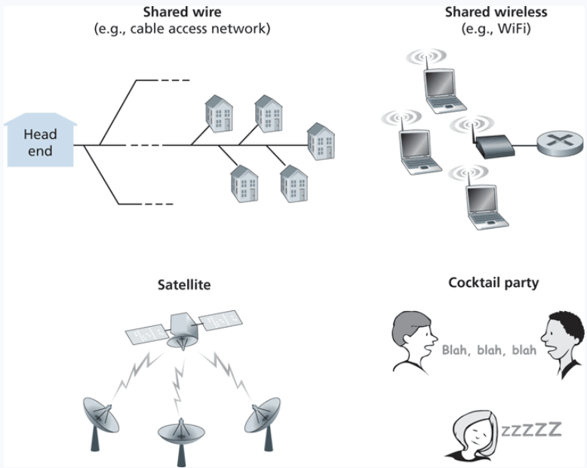
Multiple Access Links
Shared medium = possibility for receivers to get two frame at the same time, AKA a collision
Frame X
Frame y
Frames get tangled together, and neither frame can be read clearly by receiver

Slide 23
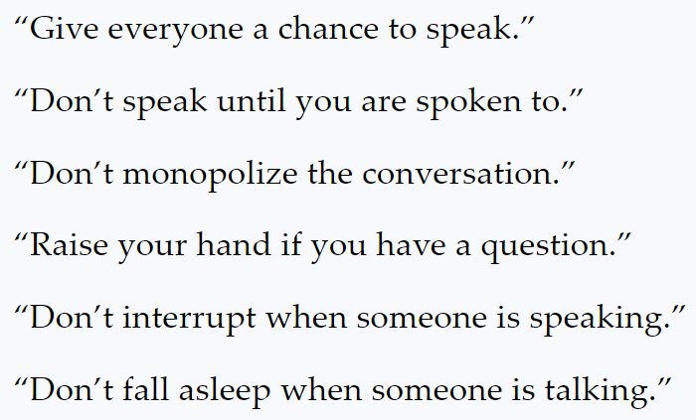
Multiple Access Links
Shared medium = possibility for receivers to get two frame at the same time, AKA a collision
Frame X
Frame y
Frames get tangled together, and neither frame can be read clearly by receiver
In English, we have some rules to prevent collisions from happening
In the link layer, we will discuss 3 multiple access protocols:
Channel Partitioning, Random Access, and Taking Turns

Slide 24
Multiple Access Links
Shared medium = possibility for receivers to get two frame at the same time, AKA a collision
Ideally
1. When one node wants to transmit, it can send at rate R:
2. When M nodes want to transmit, each can send at average rate R/M
3. Fully decentralized:
no special node to coordinate transmissions
no synchronization of clocks, slots
4. simple
Frame X
Frame y
Frames get tangled together, and neither frame can be read clearly by receiver
In English, we have some rules to prevent collisions from happening
In the link layer, we will discuss 3 multiple access protocols:
Channel Partitioning, Random Access, and Taking Turns

Slide 25
Channel Partitioning
Links total bandwidth = D
Divide channel into N slots
Each node gets (on average) D/N bandwidth
Get to transmit data for a fixed amount of time, and then next node gets to transmit
A
B
C
D
N nodes
A
B
C
D

Slide 26
Channel Partitioning
Links total bandwidth = D
Divide channel into N slots
Each node gets (on average) D/N bandwidth
Get to transmit data for a fixed amount of time, and then next node gets to transmit
A
B
C
D
N nodes
A
B
C
D

Slide 27
Channel Partitioning
Links total bandwidth = D
Divide channel into N slots
Each node gets (on average) D/N bandwidth
Get to transmit data for a fixed amount of time, and then next node gets to transmit
A
B
C
D
N nodes
A
B
C
D

Slide 28
Channel Partitioning
Links total bandwidth = D
Divide channel into N slots
Each node gets (on average) D/N bandwidth
Get to transmit data for a fixed amount of time, and then next node gets to transmit
A
B
C
D
N nodes
A
B
C
D

Slide 29
Channel Partitioning
Links total bandwidth = D
Divide channel into N slots
Each node gets (on average) D/N bandwidth
Get to transmit data for a fixed amount of time, and then next node gets to transmit
A
B
C
D
N nodes
A
B
C
D

Slide 30
Channel Partitioning
Links total bandwidth = D
Divide channel into N slots
Each node gets (on average) D/N bandwidth
Get to transmit data for a fixed amount of time, and then next node gets to transmit
A
B
C
D
N nodes
A
B
C
D

Slide 31
Channel Partitioning
Links total bandwidth = D
Divide channel into N slots
Each node gets (on average) D/N bandwidth
Get to transmit data for a fixed amount of time, and then next node gets to transmit
A
B
C
D
N nodes
A
B
C
D

Slide 32
Channel Partitioning
Links total bandwidth = D
Divide channel into N slots
Each node gets (on average) D/N bandwidth
Get to transmit data for a fixed amount of time, and then next node gets to transmit
A
B
C
D
N nodes
A
B
C
D

Slide 33
Channel Partitioning
Links total bandwidth = D
Divide channel into N slots
Each node gets (on average) D/N bandwidth
Get to transmit data for a fixed amount of time, and then next node gets to transmit
A
B
C
D
N nodes
A
B
C
D

Slide 34
Random Access
Collisions will occur, but we will try to recover from them
Slotted ALOHA: Divide up time into discrete L/R “slots”
L = size of frame
R = Bandwidth
If collisions occur, the colliding nodes will flip a coin to see who should retransmit
L/R = Time needed to transmit one frame
L/R
2 L/R
3 L/R
…
Can only transmit frames at beginning of slots. If collision occurs, the nodes can detect collision before the slot ends

Slide 35
Random Access
Collisions will occur, but we will try to recover from them
Slotted ALOHA: Divide up time into discrete L/R “slots”
L = size of frame
R = Bandwidth
If collisions occur, the colliding nodes will flip a coin to see who should retransmit
L/R = Time needed to transmit one frame
L/R
2 L/R
3 L/R
…
Collision

Slide 36
Random Access
Collisions will occur, but we will try to recover from them
Slotted ALOHA: Divide up time into discrete L/R “slots”
L = size of frame
R = Bandwidth
If collisions occur, the colliding nodes will flip a coin to see who should retransmit
L/R = Time needed to transmit one frame
L/R
2 L/R
3 L/R
…
Collision
Do some probability p and retransmit if needed

Slide 37
Random Access
Collisions will occur, but we will try to recover from them
Slotted ALOHA: Divide up time into discrete L/R “slots”
L = size of frame
R = Bandwidth
If collisions occur, the colliding nodes will flip a coin to see who should retransmit
L/R = Time needed to transmit one frame
L/R
2 L/R
3 L/R
…
Waiting a random delay
Collision
Empty
Collision

Slide 38
Random Access
Collisions will occur, but we will try to recover from them
Slotted ALOHA: Divide up time into discrete L/R “slots”
L = size of frame
R = Bandwidth
If collisions occur, the colliding nodes will flip a coin to see who should retransmit
L/R = Time needed to transmit one frame
L/R
2 L/R
3 L/R
…
Waiting a random delay
Waiting a random delay
Collision
Empty
Collision
Success

Slide 39
Random Access
Collisions will occur, but we will try to recover from them
Slotted ALOHA: Divide up time into discrete L/R “slots”
L = size of frame
R = Bandwidth
If collisions occur, the colliding nodes will flip a coin to see who should retransmit
L/R = Time needed to transmit one frame
L/R
2 L/R
3 L/R
…
Waiting a random delay
Waiting a random delay
Waiting a random delay
Collision
Empty
Collision
Success
Empty
Collision

Slide 40
Random Access
Collisions will occur, but we will try to recover from them
Slotted ALOHA: Divide up time into discrete L/R “slots”
L = size of frame
R = Bandwidth
If collisions occur, the colliding nodes will flip a coin to see who should retransmit
L/R = Time needed to transmit one frame
L/R
2 L/R
3 L/R
…
Waiting a random delay
Waiting a random delay
Waiting a random delay
Collision
Empty
Collision
Success
Empty
Collision
Success

Slide 41
Random Access
Collisions will occur, but we will try to recover from them
Slotted ALOHA: Divide up time into discrete L/R “slots”
L = size of frame
R = Bandwidth
If collisions occur, the colliding nodes will flip a coin to see who should retransmit
L/R = Time needed to transmit one frame
L/R
2 L/R
3 L/R
…
Waiting a random delay
Waiting a random delay
Waiting a random delay
Collision
Empty
Collision
Success
Empty
Collision
Success
Success

Slide 42

Taking Turns
Token Passing
Nodes are connected in a circular manner, and pass a special frame (token) between each other
Can only transmit messages if you have the token

Slide 43
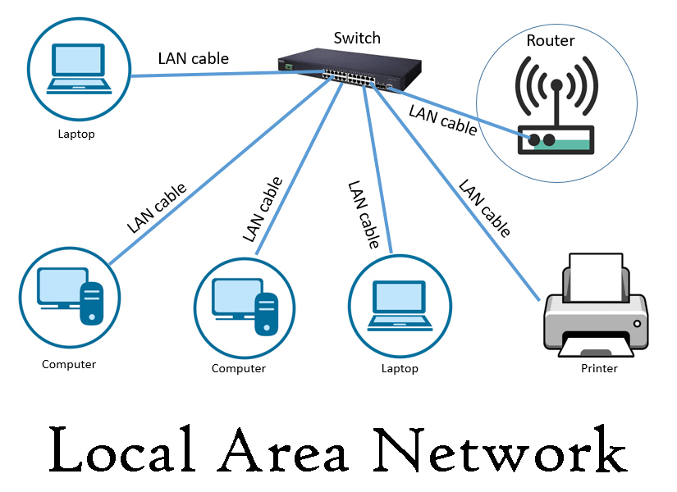
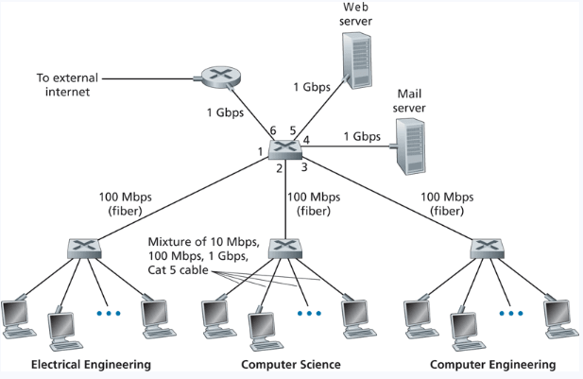
LAN
Local Area Network (LAN)- A collection of devices in one physical location, typically that share a centralized internet connection
Router
Switch

Slide 44
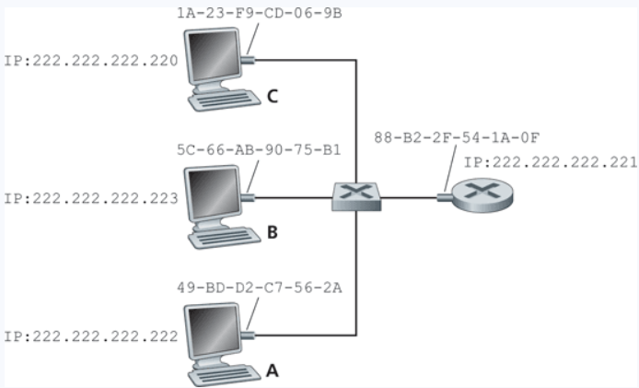
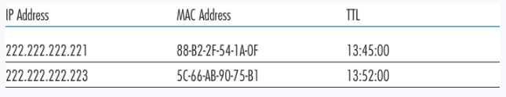
ARP
Protocol for mapping IP Addresses to MAC addresses
Used only for hosts and router interfaces on the same subnet
First the machine checks its ARP table
If the entry does not exist in the table, construct and send an ARP packet
Broadcasts the ARP packet to all interfaces on the LAN (255.255.255.255)
These tables are self-updated, and do not require manual entry*

Slide 45
ARP
A wants to send datagram to B
B’s MAC address not in A’s ARP table.
A broadcasts ARP query packet, containing B's IP address
destination MAC address = FF-FF-FF-FF-FF-FF
all nodes on LAN receive ARP query
B receives ARP packet, replies to A with its (B's) MAC address
frame sent to A’s MAC address (unicast)
A caches (saves) IP-to-MAC address pair in its ARP table until information becomes old (times out)
soft state: information that times out (goes away) unless refreshed
ARP is “plug-and-play”:
nodes create their ARP tables without intervention from net administrator

Slide 46

Putting it Together: Sending from LAN to LAN
A creates IP datagram with IP source A, destination B
A creates link-layer frame with R's MAC address as destination address, frame contains A-to-B IP datagram
MAC src: 74-29-9C-E8-FF-55
MAC dest: E6-E9-00-17-BB-4B
IP
Eth
Phy
IP src: 111.111.111.111
IP dest: 222.222.222.222
A
B
R
111.111.111.111
222.222.222.222
74-29-9C-E8-FF-55
49-BD-D2-C7-56-2A
222.222.222.220
1A-23-F9-CD-06-9B
111.111.111.112
111.111.111.110
222.222.222.221
CC-49-DE-D0-AB-7D
E6-E9-00-17-BB-4B
88-B2-2F-54-1A-0F
Link Layer and LANs
6-48

Slide 47
Putting it Together: Sending from LAN to LAN
A creates IP datagram with IP source A, destination B
A creates link-layer frame with R's MAC address as destination address, frame contains A-to-B IP datagram
MAC src: 74-29-9C-E8-FF-55
MAC dest: E6-E9-00-17-BB-4B
IP
Eth
Phy
IP src: 111.111.111.111
IP dest: 222.222.222.222
A
B
R
111.111.111.111
222.222.222.222
74-29-9C-E8-FF-55
49-BD-D2-C7-56-2A
222.222.222.220
1A-23-F9-CD-06-9B
111.111.111.112
111.111.111.110
222.222.222.221
CC-49-DE-D0-AB-7D
E6-E9-00-17-BB-4B
88-B2-2F-54-1A-0F
Link Layer and LANs
6-47

Slide 48
Putting it Together: Sending from LAN to LAN
R forwards datagram with IP source A, destination B
R creates link-layer frame with B's MAC address as destination address, frame contains A-to-B IP datagram
MAC src: 1A-23-F9-CD-06-9B
MAC dest: 49-BD-D2-C7-56-2A
IP
Eth
Phy
IP
Eth
Phy
IP src: 111.111.111.111
IP dest: 222.222.222.222
A
B
R
111.111.111.111
222.222.222.222
74-29-9C-E8-FF-55
49-BD-D2-C7-56-2A
222.222.222.220
1A-23-F9-CD-06-9B
111.111.111.112
111.111.111.110
222.222.222.221
CC-49-DE-D0-AB-7D
E6-E9-00-17-BB-4B
88-B2-2F-54-1A-0F
Link Layer and LANs

Slide 49
Putting it Together: Sending from LAN to LAN
R forwards datagram with IP source A, destination B
R creates link-layer frame with B's MAC address as dest, frame contains A-to-B IP datagram
MAC src: 1A-23-F9-CD-06-9B
MAC dest: 49-BD-D2-C7-56-2A
IP src: 111.111.111.111
IP dest: 222.222.222.222
IP
Eth
Phy
A
B
R
111.111.111.111
222.222.222.222
74-29-9C-E8-FF-55
49-BD-D2-C7-56-2A
222.222.222.220
1A-23-F9-CD-06-9B
111.111.111.112
111.111.111.110
222.222.222.221
CC-49-DE-D0-AB-7D
E6-E9-00-17-BB-4B
88-B2-2F-54-1A-0F

Slide 50
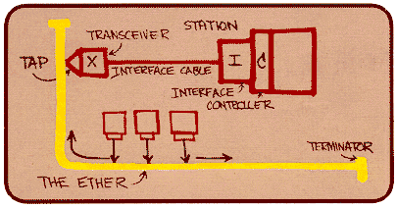
Ethernet
“dominant” wired LAN technology:
single chip, multiple speeds (e.g., Broadcom BCM5761)
first widely used LAN technology
simpler, cheap
kept up with speed race: 10 Mbps – 10 Gbps
Metcalfe’s Ethernet sketch

Slide 51

Ethernet
Ethernet Topology
switch
star
bus: coaxial cable
(outdated)
Link Layer and LANs

Slide 52
Ethernet frame structure
sending adapter encapsulates IP datagram (or other network layer protocol packet) in Ethernet frame
preamble:
7 bytes with pattern 10101010 followed by one byte with pattern 10101011
used to synchronize receiver, sender clock rates
type
preamble
dest.
address
source
address
data (payload)
CRC

Slide 53
Ethernet frame structure (more)
addresses: 6 byte source, destination MAC addresses
if adapter receives frame with matching destination address, or with broadcast address (e.g. ARP packet), it passes data in frame to network layer protocol
otherwise, adapter discards frame
type: indicates higher layer protocol (mostly IP but others possible, e.g., Novell IPX, AppleTalk)
CRC: cyclic redundancy check at receiver
error detected: frame is dropped
type
preamble
dest.
address
source
address
data (payload)
CRC

Slide 54

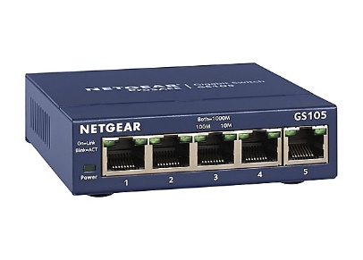
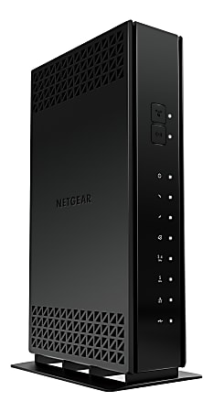







Ethernet switch
Switches will store and forward ethernet frames
Hosts have dedicated, direct connection to switch
Ethernet protocol used on each incoming link, but no collisions between links
Switching: A-A’ and B-B’ can transmit simultaneously, without collisions
Transparent: Hosts are not aware
they are connected to a switch
Plug and play; self-learning
A
C’
B
6
1
2
5
4
3
B’
C
= ethernet cable
A’

Slide 55
Switches vs. routers
application
transport
network
link
physical
both are store-and-forward:
routers: network-layer devices (examine network-layer headers)
switches: link-layer devices (examine link-layer headers)
both have forwarding tables:
routers: compute tables using routing algorithms, IP addresses
switches: learn forwarding table using flooding, learning, MAC addresses
datagram
frame
link
physical
frame
switch
network
link
physical
datagram
frame
application
transport
network
link
physical

Slide 56
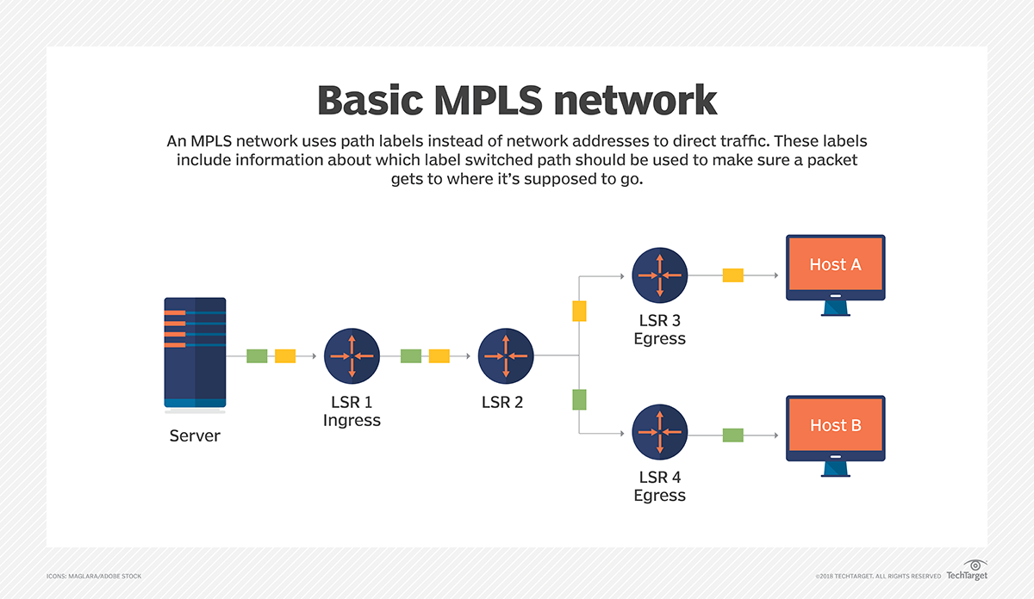
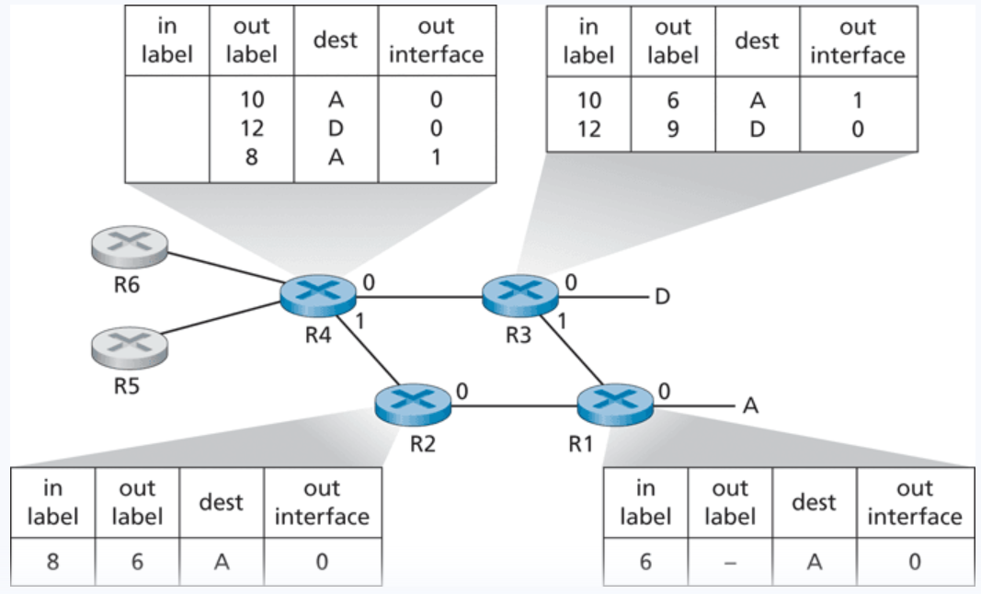
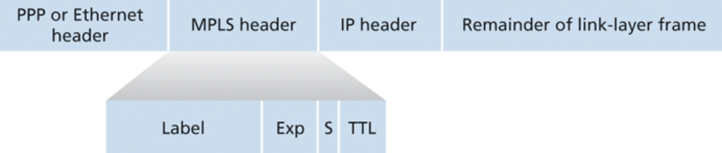
Multiprotocol
Label
Switching
Label Switch Router = LSR
This is a layer 2.5 protocol (between network layer and link layer)

Slide 57
The End of the OSI Model…
We have reached the end of the OSI, now lets review…

Slide 58
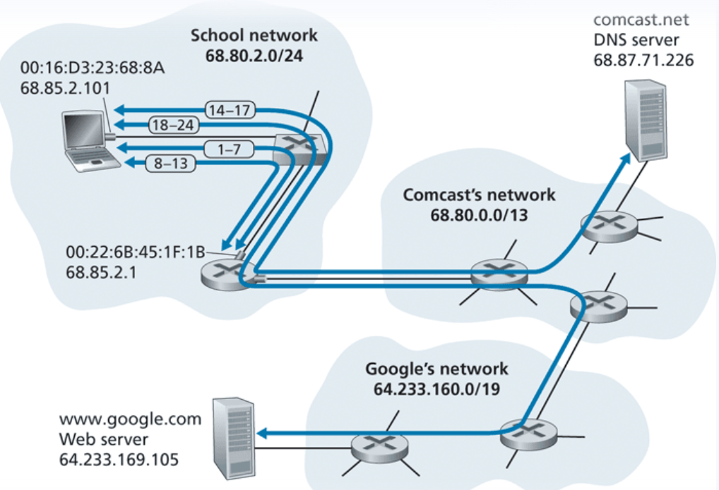

Slide 59
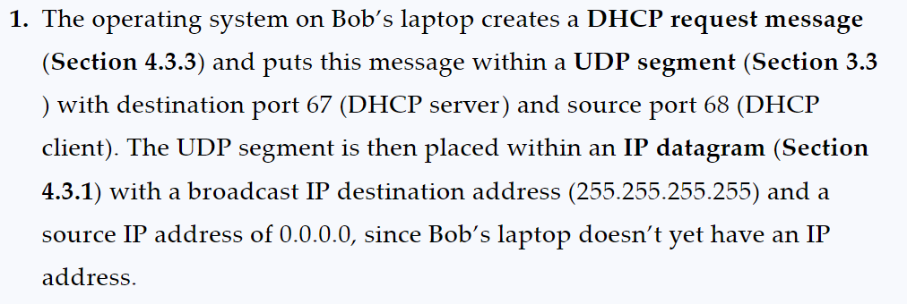

Slide 60
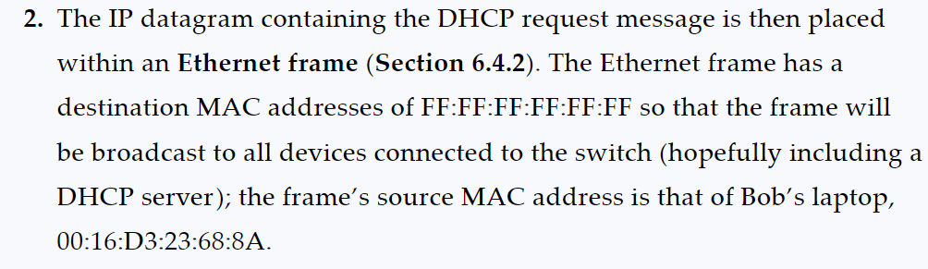

Slide 61
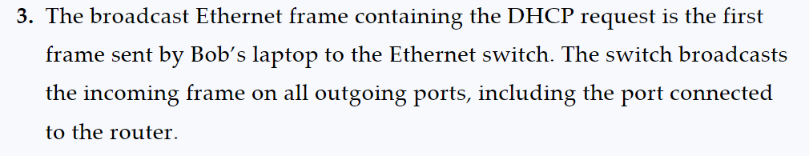

Slide 62
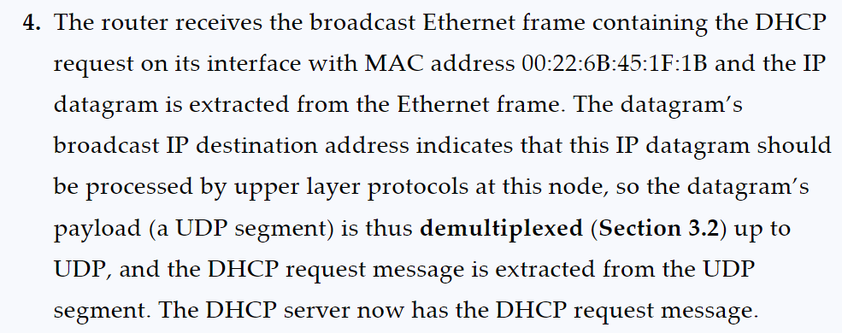
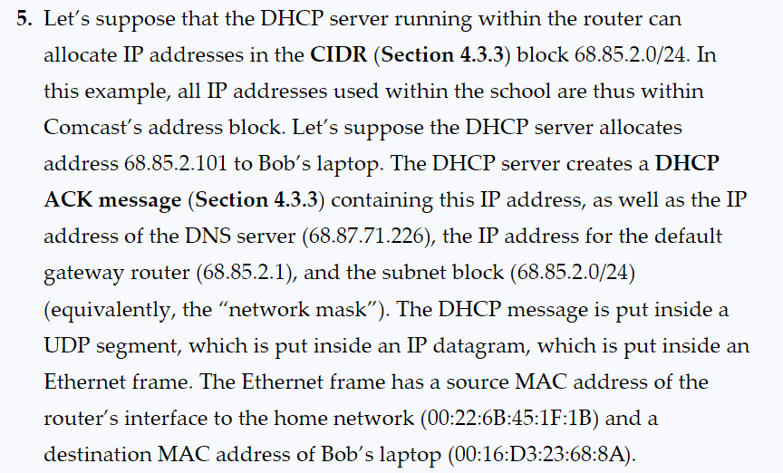

Slide 63
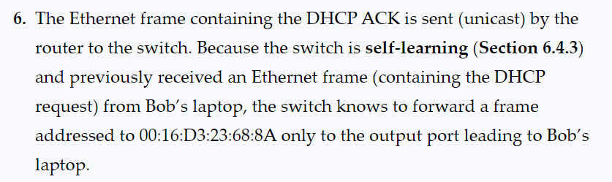
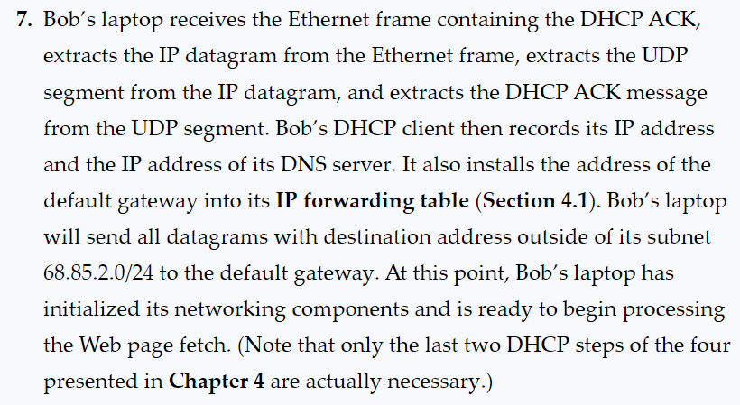
OK.. So that was just DHCP

Slide 64
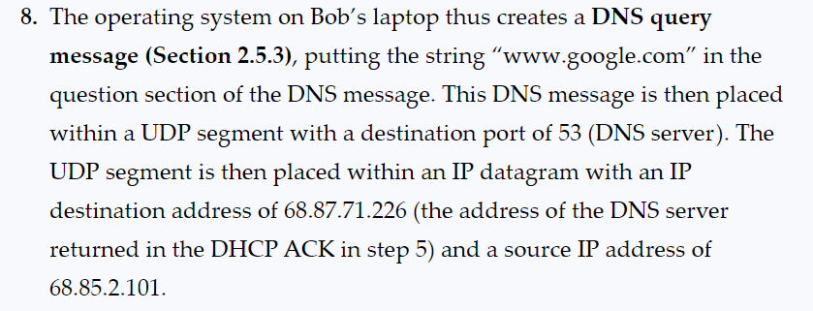

Slide 65
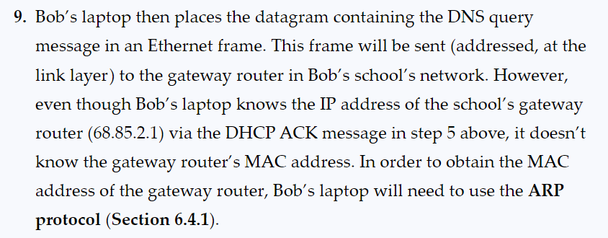
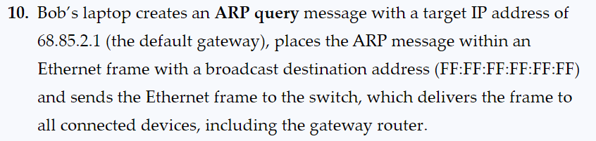

Slide 66
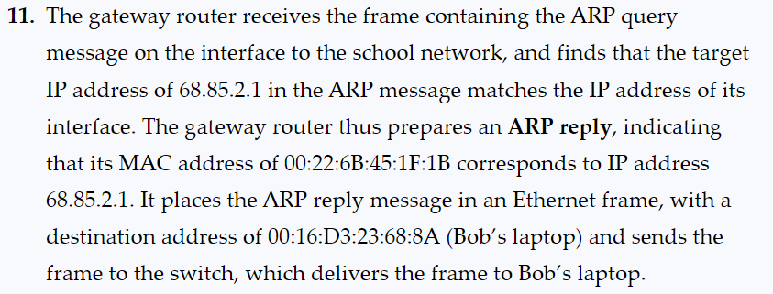

Slide 67
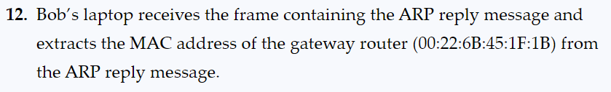

Slide 68
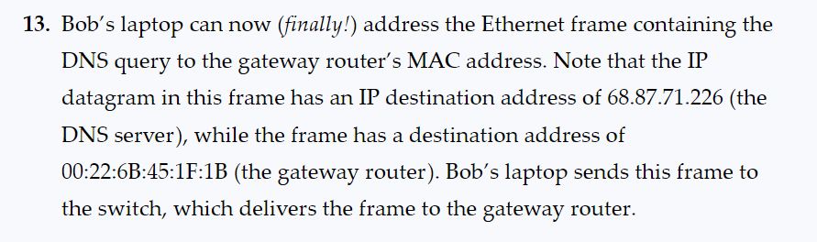
Whew… ok we can now address something to the DNS server

Slide 69
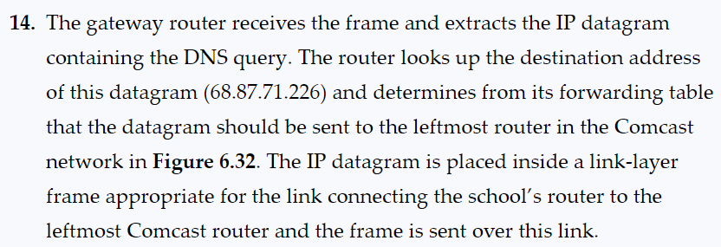

Slide 70
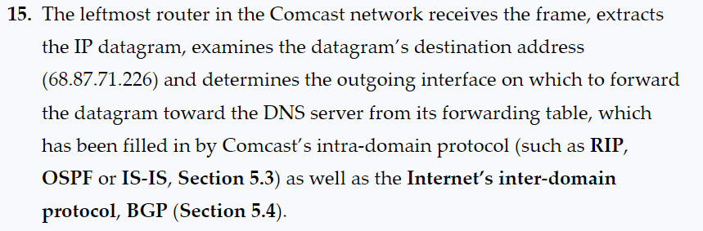

Slide 71
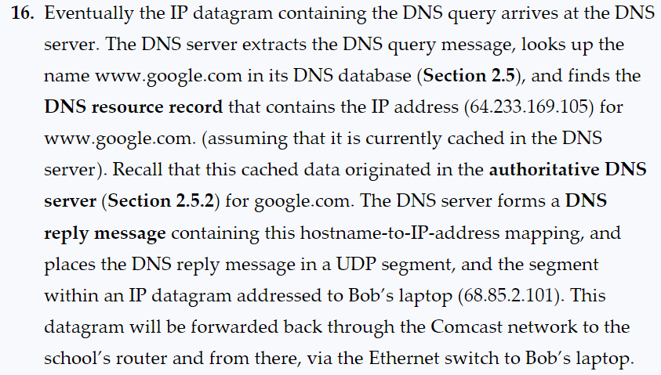

Slide 72
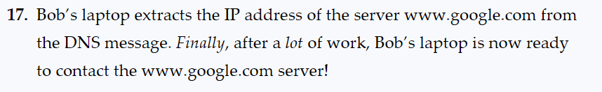
We are finally ready to contact the google server!

Slide 73
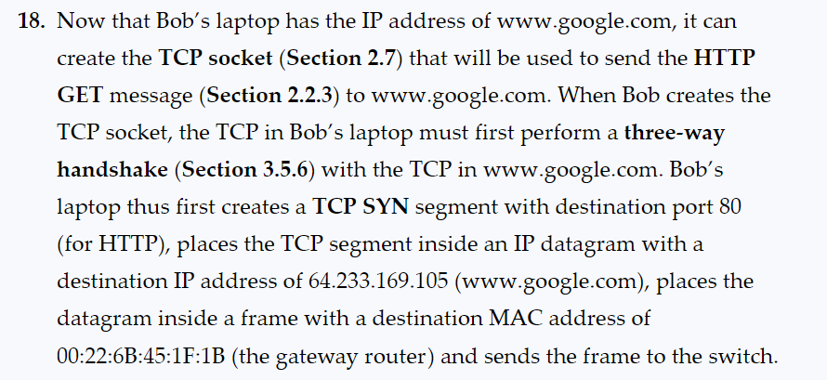

Slide 74
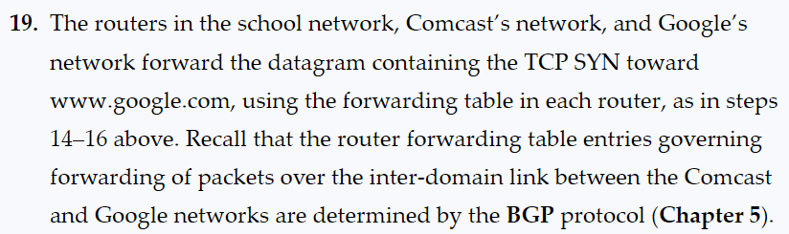

Slide 75
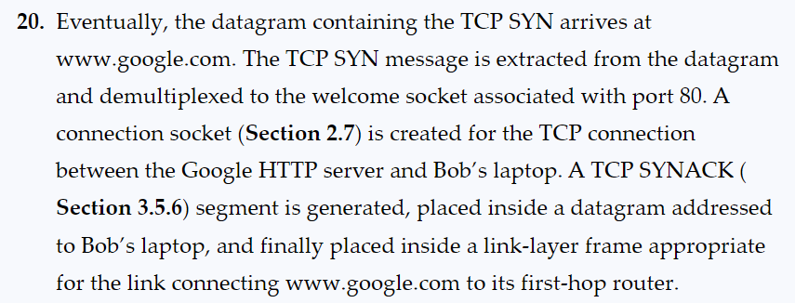

Slide 77
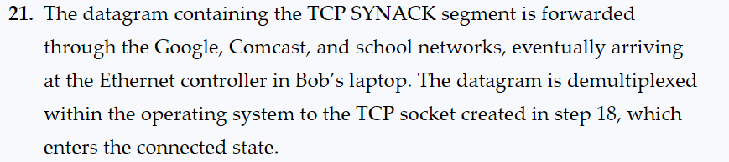

Slide 78
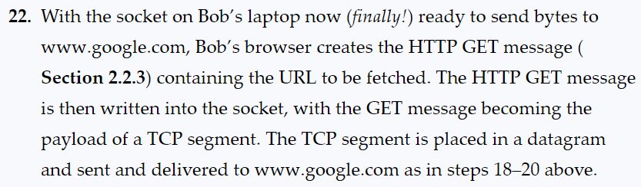

Slide 79
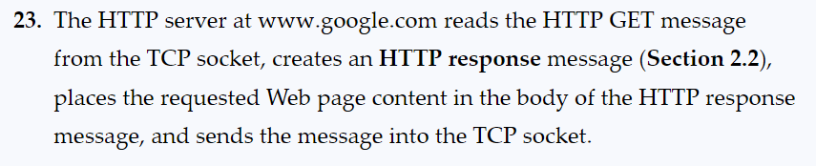

Slide 80
